Slide 1


IShowSpeech(Speech-to-Text Transcription)
Presented to : Abhishek Kumar Chouhan Sir

Slide 2

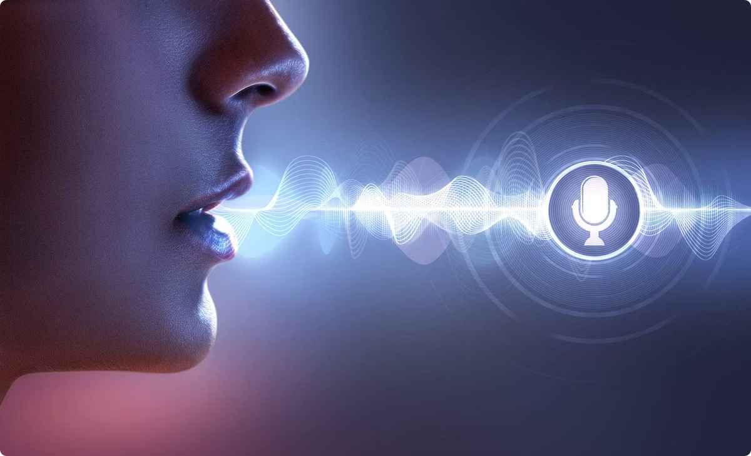
Introduction to Speech Recognition
Speech recognition converts spoken language into text. It's used widely, from voice assistants to transcription.
1
Acoustic Modeling
2
Language Modeling
Transforms audio signals into phonetic features.
Predicts sequences of words based on context.
3
Decoding
Combines acoustic and language models for transcription.

Slide 3

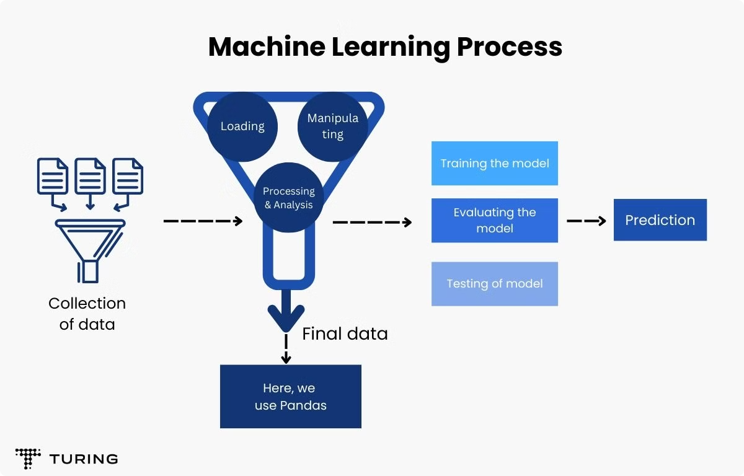
Data Collection
High-quality datasets are crucial for training accurate models. We'll use Mozilla Common Voice and LibriSpeech.
Common Voice
LibriSpeech
Crowdsourced speech data in many languages.
Large corpus of read English speech from audiobooks.

Slide 4
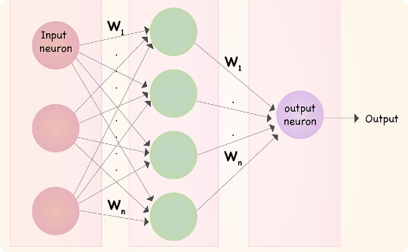
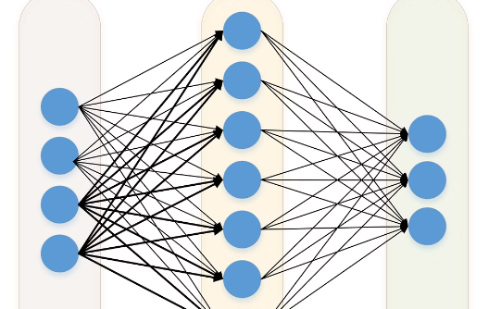
Deep Neural Networks
DNNs are powerful for speech recognition. They learn complex patterns in audio data for accurate transcription.
Input Layer
Hidden Layers
Output Layer
Raw audio features.
Feature extraction and transformation.
Predicted phonemes or words.

Slide 5
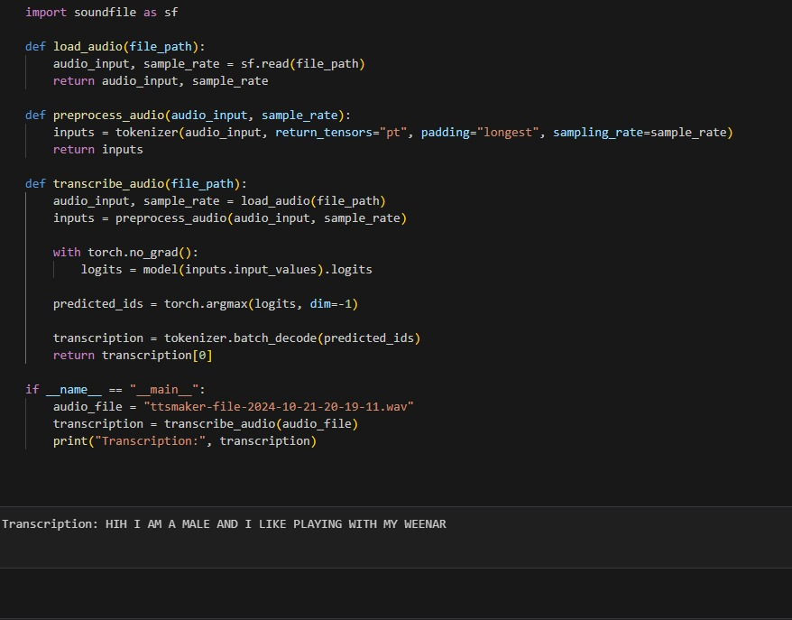
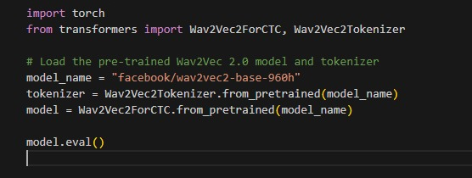

PRE TRAINED WAV2VEC2.0 MODEL

Slide 6
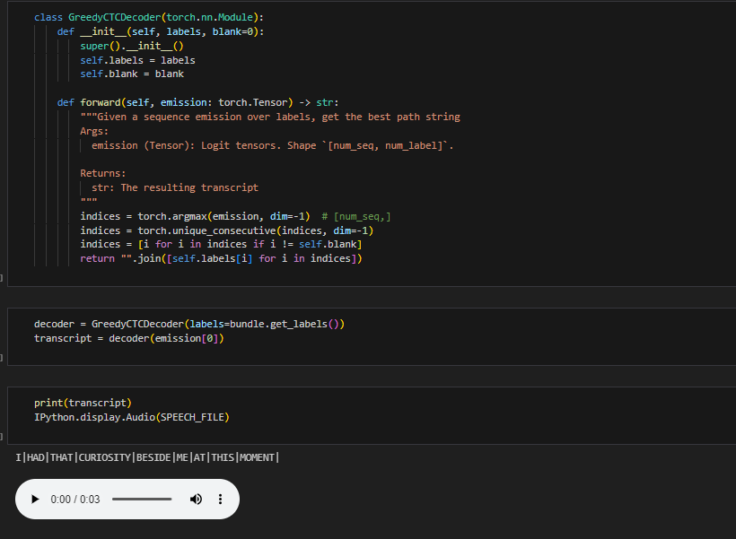
IMPROVED RESULT

Slide 7

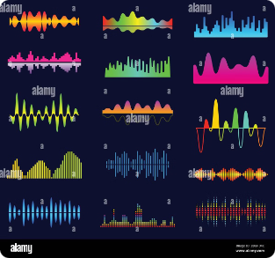
Handling Challenges
Accents, noise, and speech variations affect accuracy. Robust models address these challenges for better performance.
Challenge
Solution
Accents
Multi-lingual training data
Noise
Noise reduction techniques
Variations
Data augmentation

Slide 8


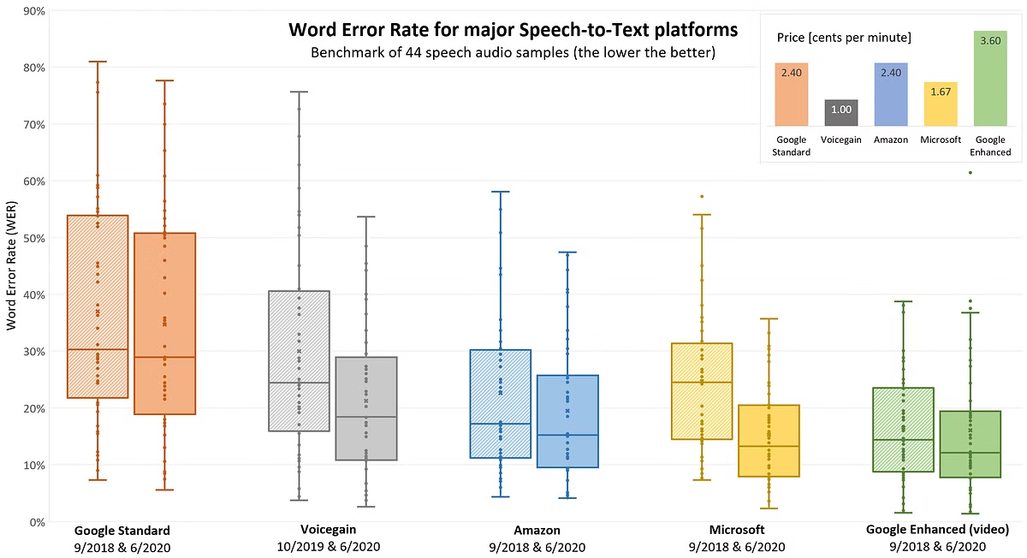


Demonstration and Results
We'll demonstrate real-world performance. This shows the accuracy and speed of our AI speech-to-text system.
Speed
Fast transcription.
Accuracy
High transcription accuracy.
Languages
Multi-language support.

Slide 9
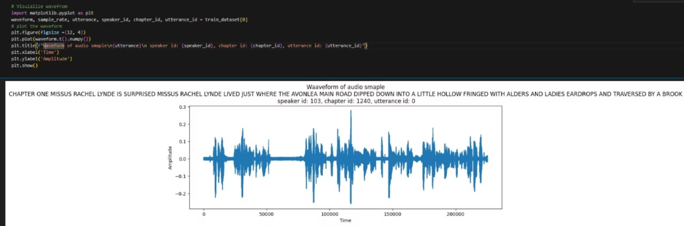
Speech to Text: Transforming Audio to Transcripts-Custom Trained Model
This presentation explores the powerful techniques used to build accurate and efficient speech recognition models. From converting raw audio data to high-performance model training and validation, we'll dive into the core components that enable transforming speech to text.

Slide 10
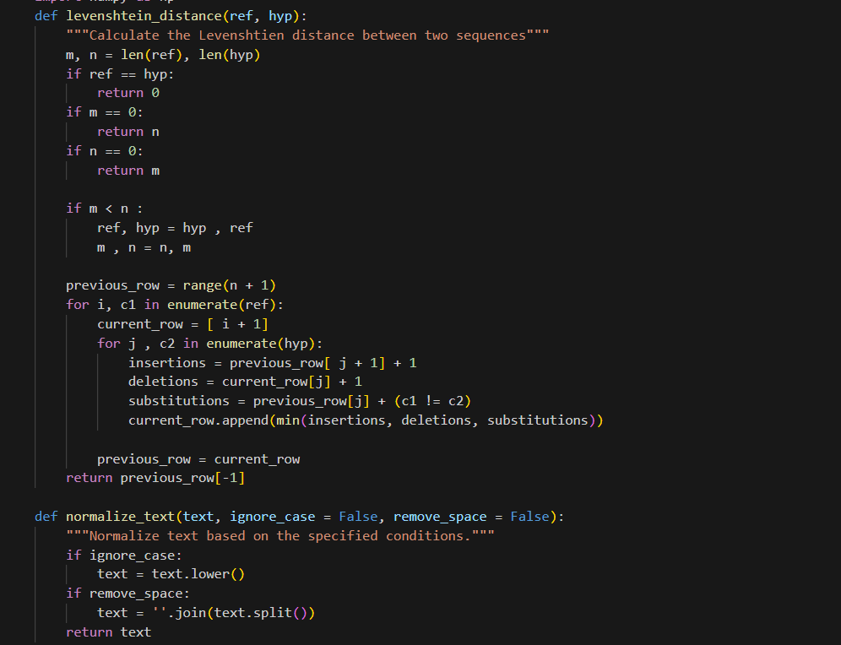
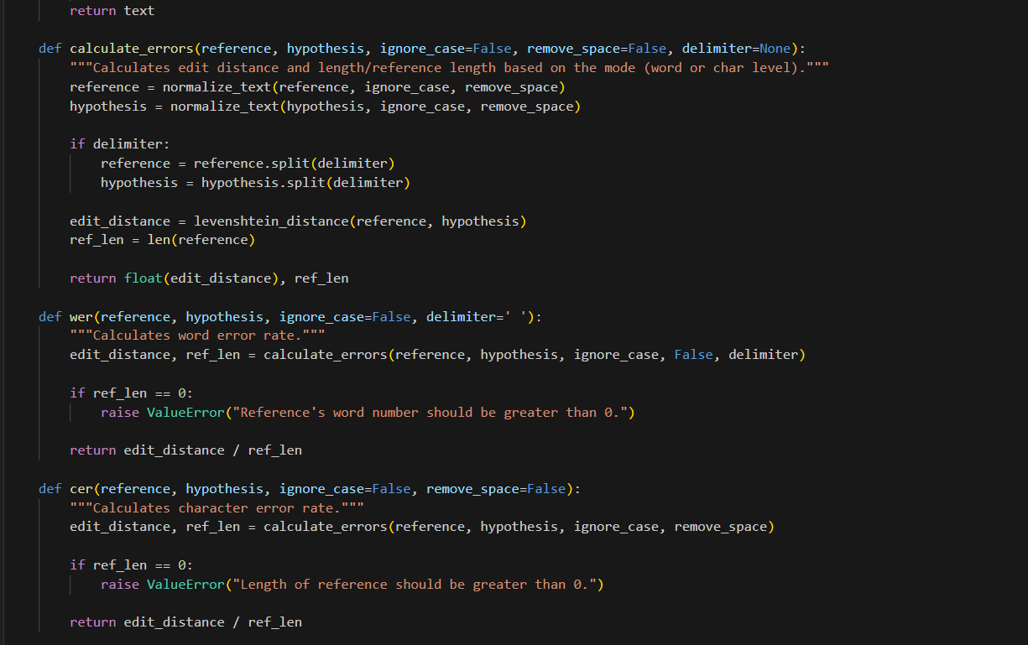
ARS METRIC

Slide 11
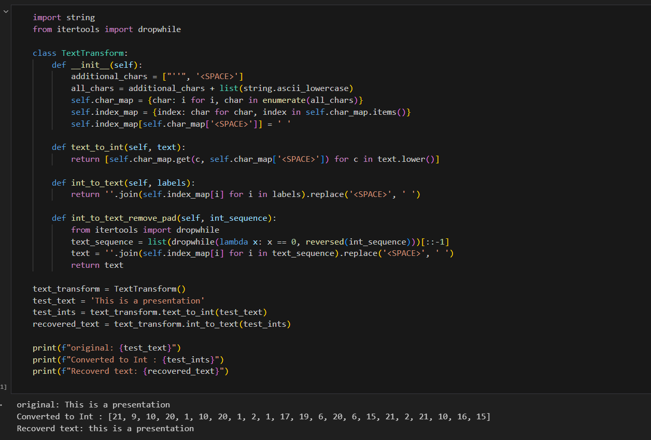
Data Preprocessing for Speech Recognition
1

Slide 12
Convolutional Neural Networks for Audio Processing
Effective Feature Extraction
Robust to Variations
Efficient Computation
CNNs are inherently invariant to shifts and distortions, making them resilient to audio variations.
The convolutional structure allows for highly parallel processing, enabling fast inference.
CNNs excel at capturing local and hierarchical patterns in spectrograms, crucial for speech recognition.

Slide 13





Bidirectional Gated Recurrent Units
Contextual Modeling
Mitigate Vanishing Gradients
Parallelizable Training
BiGRUs can capture both past and future context, crucial for sequence-to-sequence tasks like speech recognition.
Unlike traditional RNNs, BiGRUs can be trained in parallel, accelerating the training process.
The gating mechanism in GRUs helps maintain long-term dependencies and stable gradients.

Slide 14
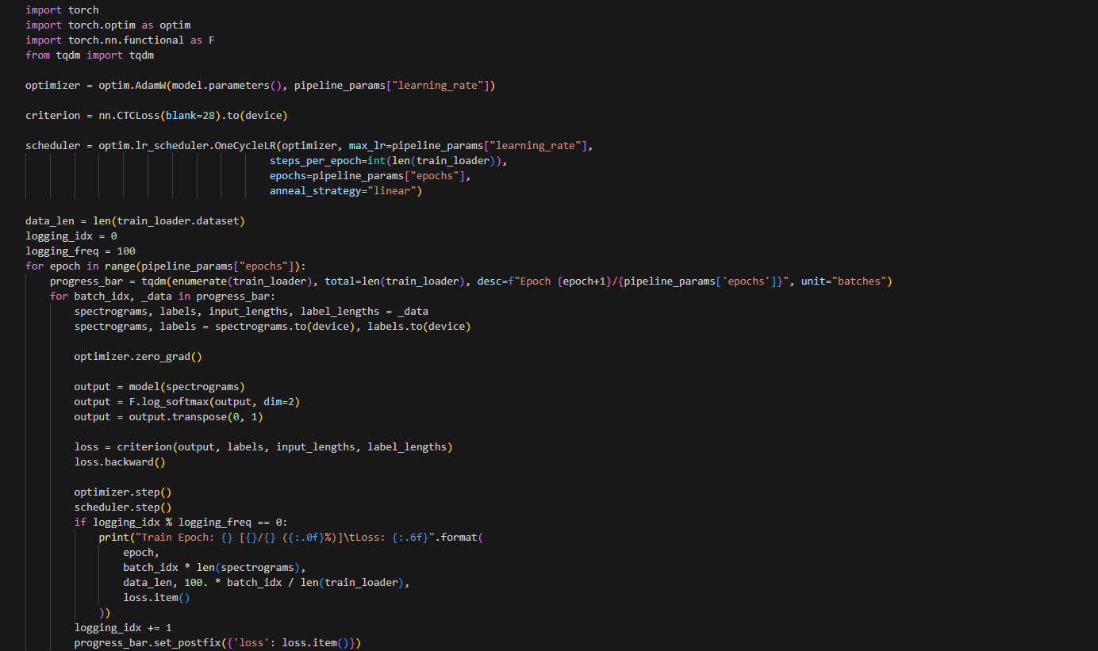
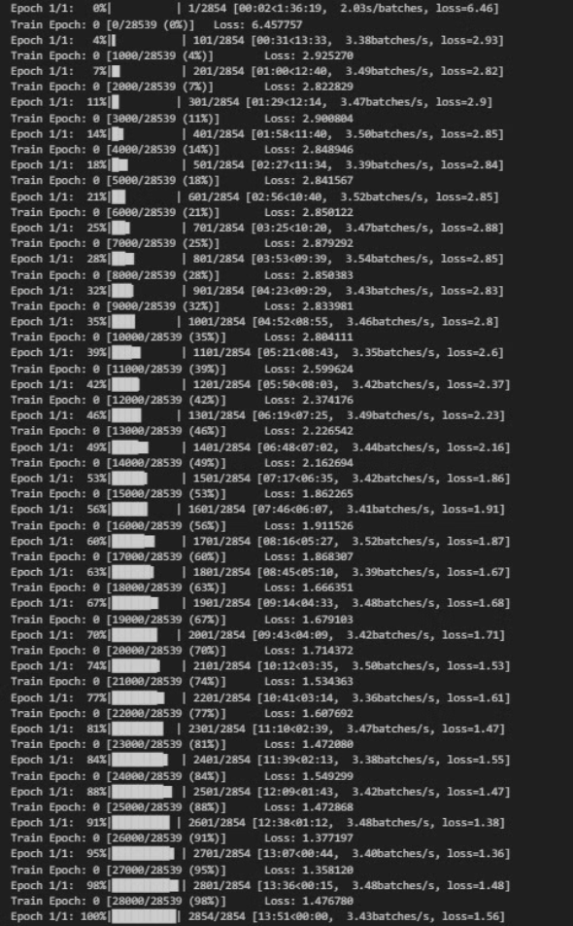



Training and Decoding the Speech Model
Data Augmentation
Optimization
Decoding
Generate synthetic data to improve robustness and generalization.
Leverage advanced optimizers like Adam to efficiently train the model.
Employ beam search to efficiently explore the output space and generate the final transcripts.

Slide 15

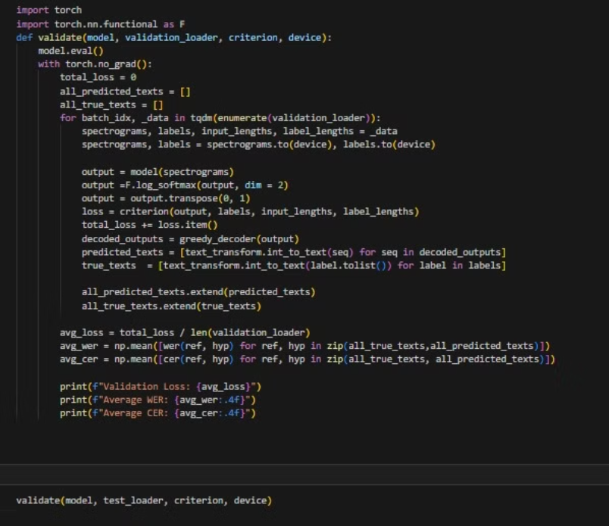
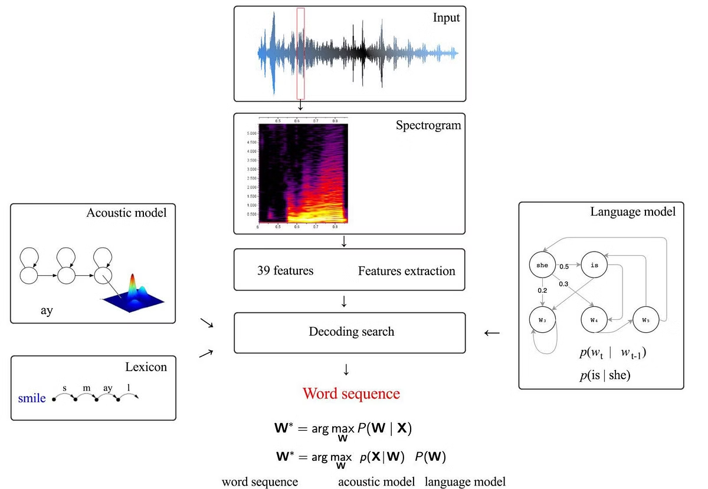
Validation and Performance Evaluation

Slide 16
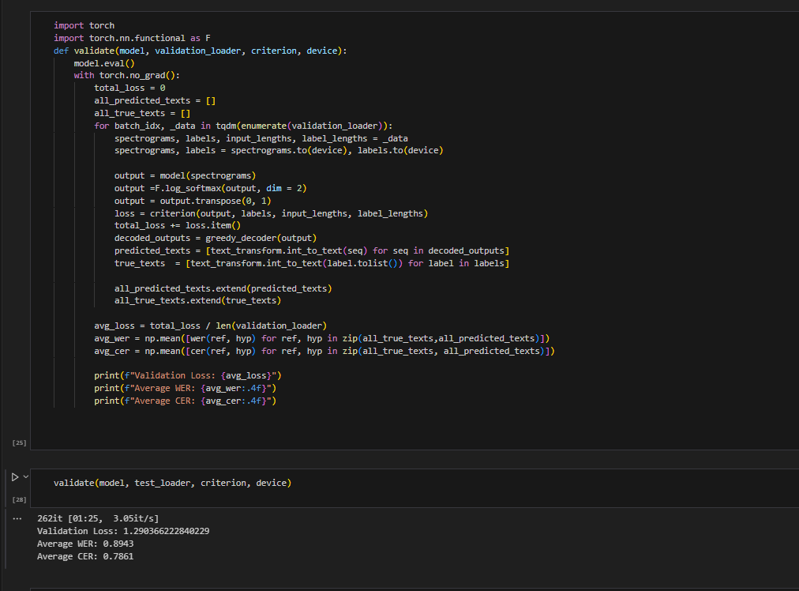
FINAL RESULT INTERMS OF WER,CER

